Slide 1
A Survey of Self-Supervised Learning Applied to Visual Assessment of Cluster Tendency
AIP Project 2023
Paritosh Tiwari
M Samuel Jayakumar

Slide 2
Introduction
Clustering is a process of grouping similar objects to identify underlying patterns.
Drawback : These methods explicitly require the number of clusters to be specified.
Our objective is to estimate the number of clusters without it being computed as hyper parameter.

Slide 3

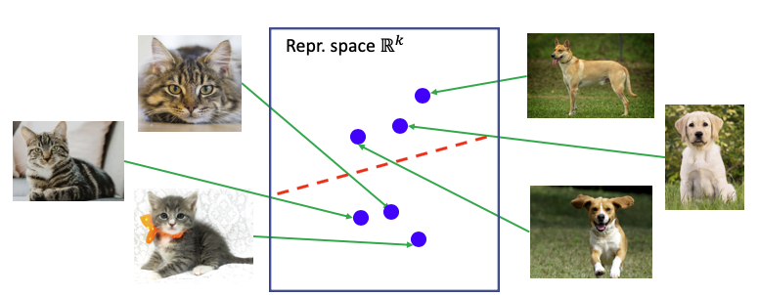
Contrastive Learning
Type of unsupervised machine learning which involves training a model to differentiate between similar and dissimilar data points.
Learn representations of the data such that similar data points are pulled closer and dissimilar points are pushed apart in the learned representations.

Slide 4
Contrastive learning Framework
Stochastic data augmentation : random cropping, random gaussian blur, etc..
A Neural Network base encoder : ResNet
A Projection Head : MLP
A contrastive loss function

Slide 5
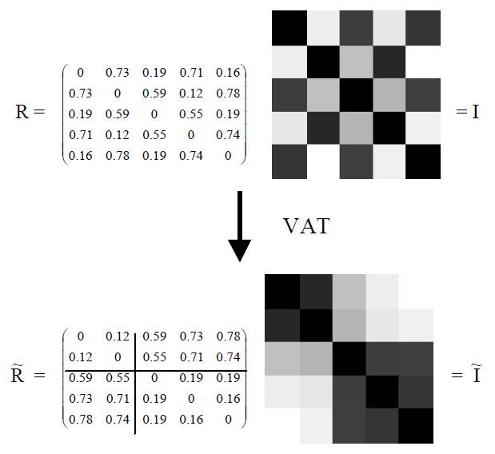
VAT
A method for visually assessing the cluster tendency of a set of objects.
A modified Prim's algorithm.
Reordering of the Dissimilarity matrix.
Variations : VAT, iVAT, Spectral VAT.

Slide 6
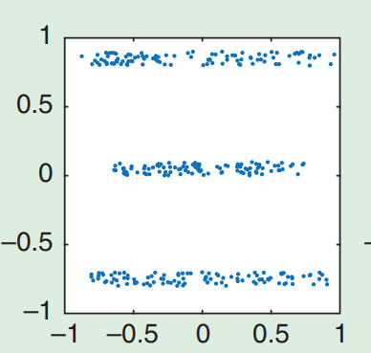
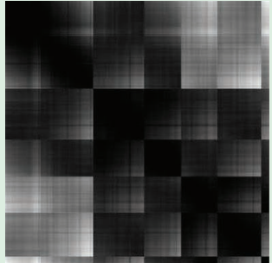
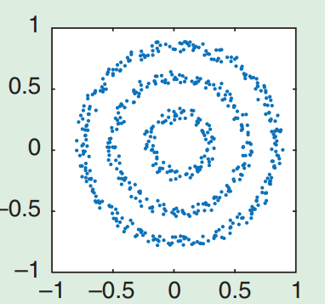
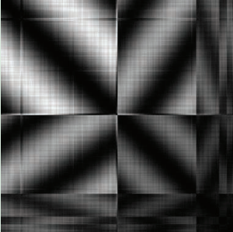
Complex Cluster Structures

Slide 7
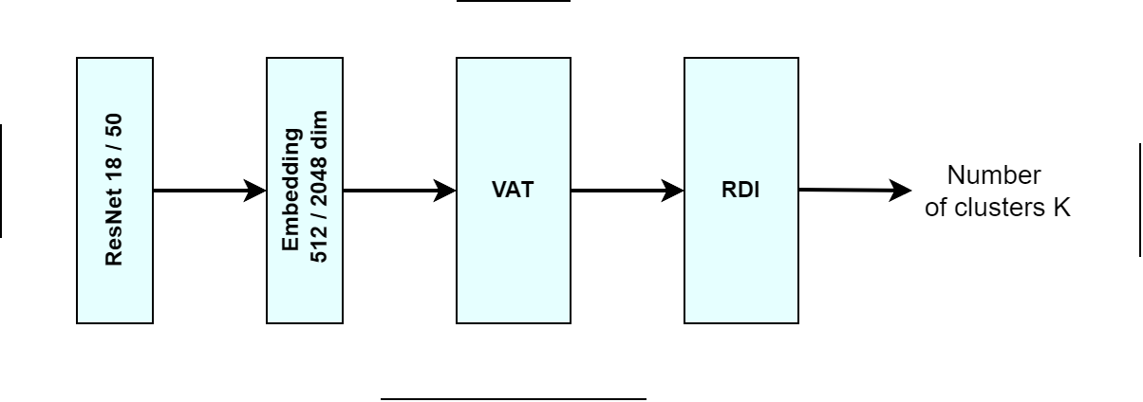
Pipeline of our Model

Slide 8
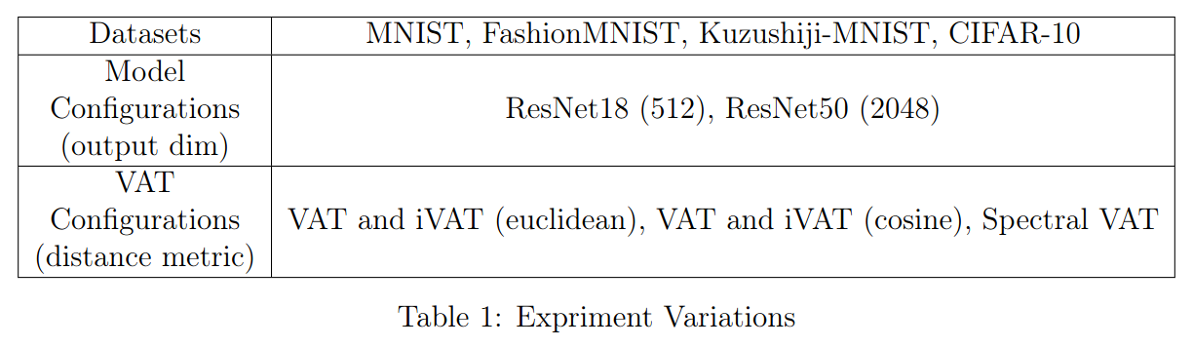
Implementation Details
We tried to experiment as many variations as possible with various datasets, SIMCLR model configurations and VAT Algorithms as shown above.

Slide 9
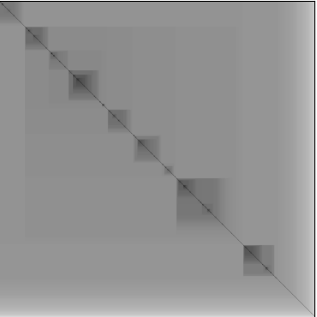
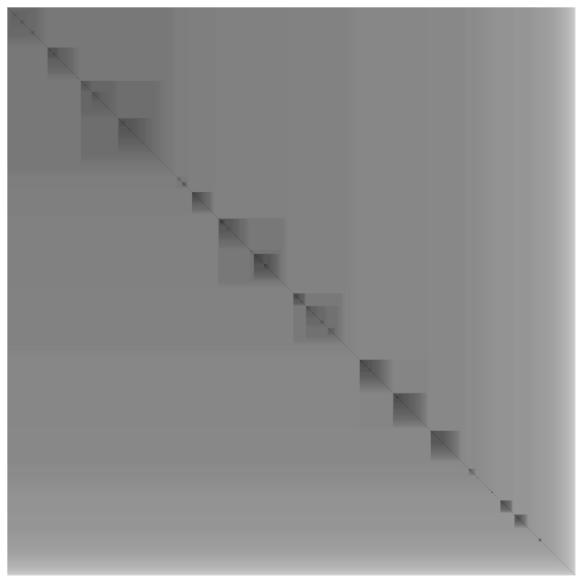
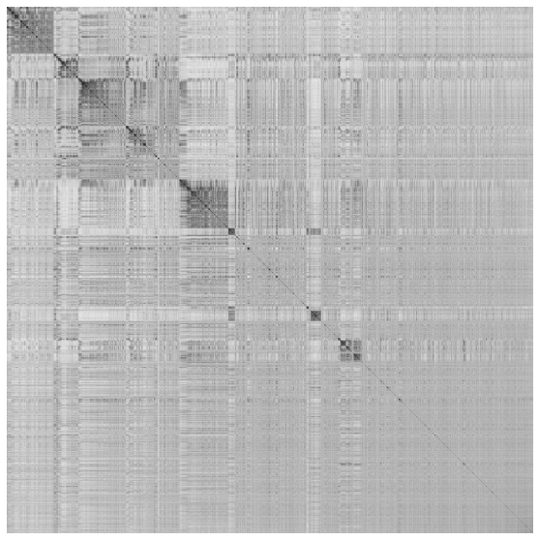
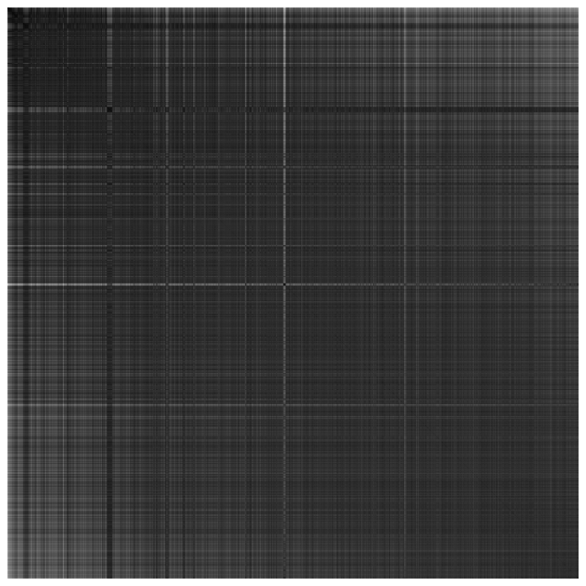
Results
MNIST dataset
Spec-VAT
Cosine similarity
K-MNIST dataset
i-VAT
Cosine similarity
F-MNIST dataset
VAT
Cosine similarity
CIFAR dataset
VAT
Euclidean Dist

Slide 10
Conclusion
We were able to extract some degree of inherent cluster structure in the datasets.
MNIST shows the best results and Spectral VAT shows comparatively better dark blocks.
The results of CIFAR-10 are expectedly worse than the grayscale datasets.
Trying other types of encoder networks, using other loss functions and downsampling the ResNet embeddings might improve the results.

Slide 11
Thank You

